Slide 1
WANDER VISTA
Travel and Nature Exploration Website
Team Leader : Hemachandrika
Team Leader : Monisha

Slide 2
INTRODUCTION
Wander Vista is a modern Travel and Nature Exploration Website
designed to help people discover beautiful destinations, nature,
adventure, culture and travel experiences. The website provides
useful travel information through an attractive, simple and
user-friendly design.

Slide 3
OBJECTIVE
The main objective of Wander Vista is to create a user-friendly
and responsive travel website that helps users explore beautiful
destinations, nature, adventure activities, culture and useful
travel information in one place.

Slide 4
TECHNOLOGIES USED
HTML
CSS
Visual Studio Code
Responsive Web Design

Slide 5
WEBSITE FEATURES
Travel destinations
Adventure activities
Shopping
Art and Culture
Travel information
Responsive Design

Slide 6


Slide 7
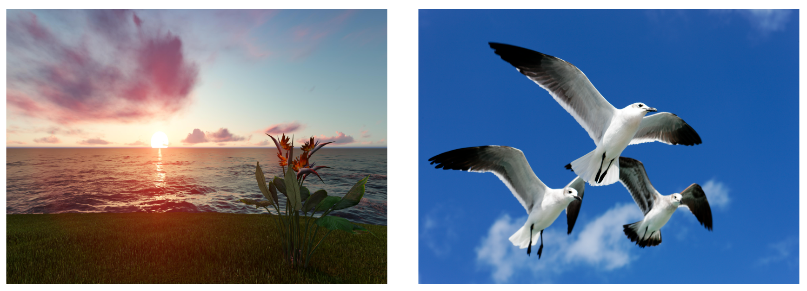

Slide 8


Slide 9
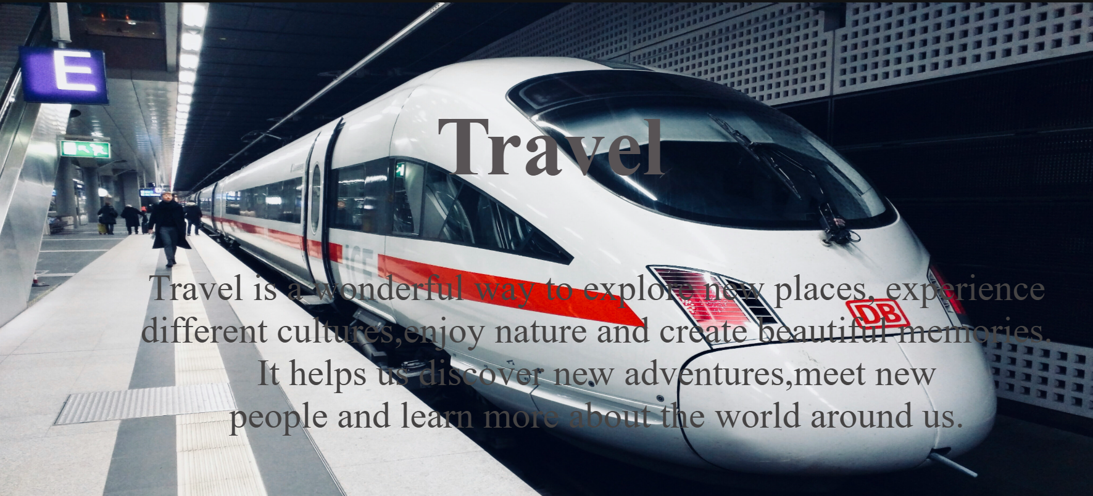

Slide 10


Slide 11
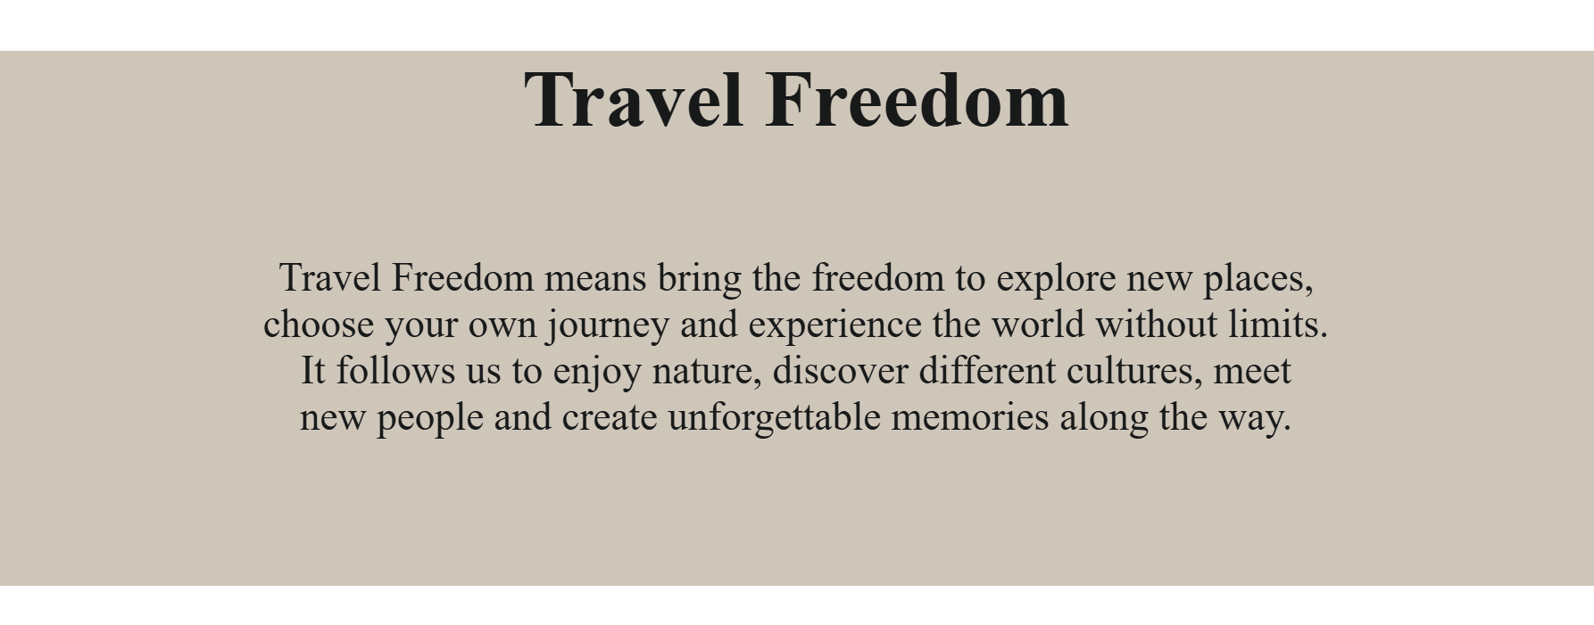

Slide 12
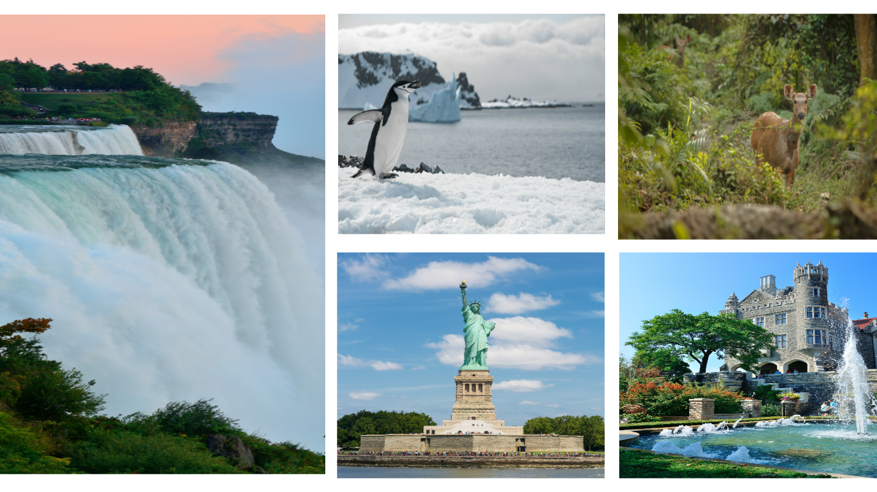

Slide 13
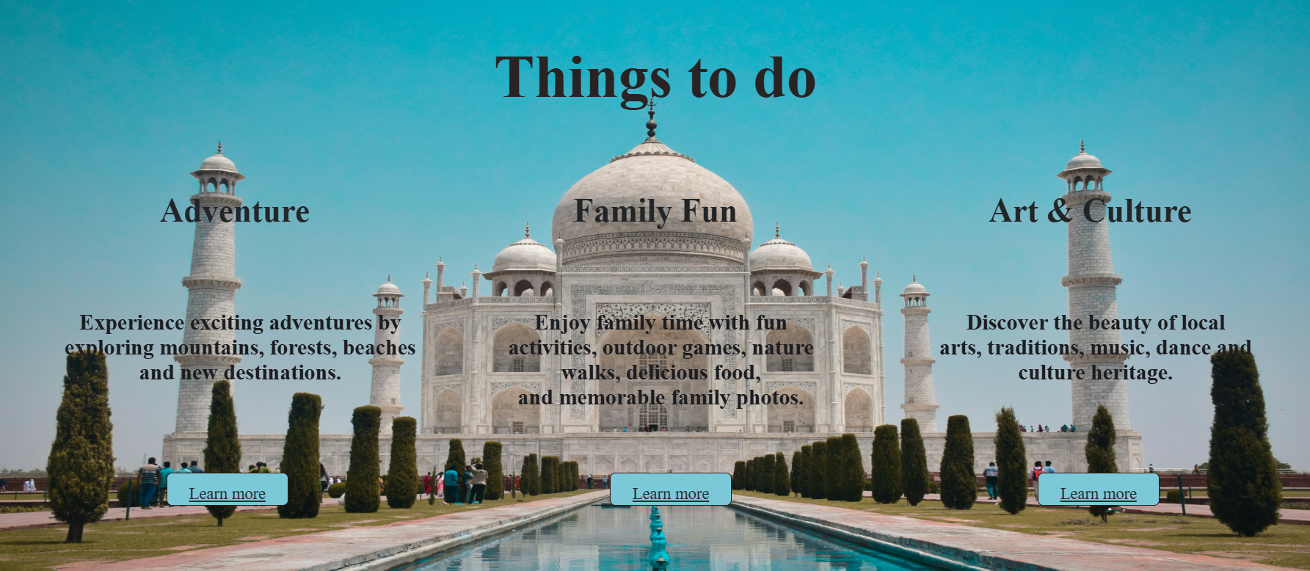

Slide 14


Slide 15
CONCLUSION
Wander Vista provides a simple, attractive and responsive platform
for exploring beautiful travel destinations and nature experiences.
The websites makes travel information easy to discover and
encourages users to explore, travel and discover new places.

